Slide 1
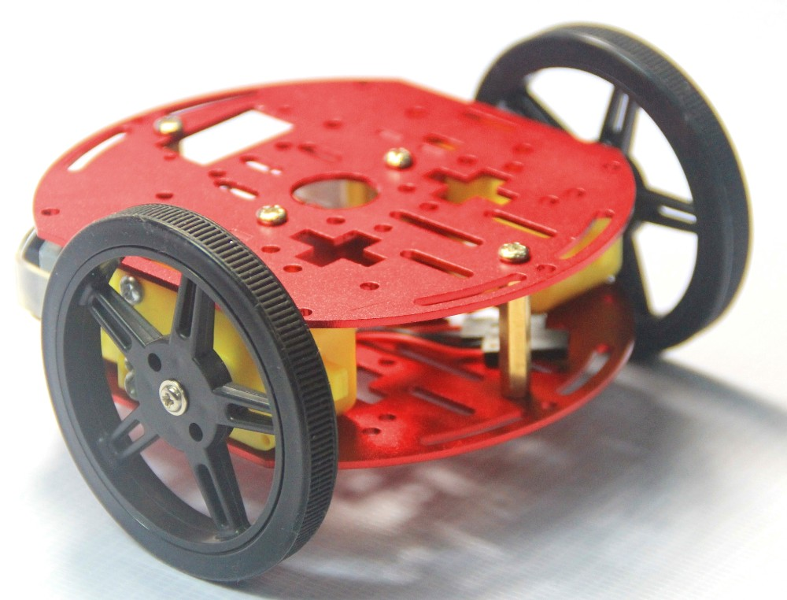
MOBILE CONTROLLER CAR WITH OBSTACLE AVOIDER
MADE BY-
SUJAY ALASPURE
LOKESH DEVGHARE
GUIDED BY-
PROF M. W. NASIM

Slide 2
INTRODUCTION
Bluetooth controlled car is controlled by using Android mobile phone
Here only needs to touch button in android phone to control the car in forward, backward, left and right directions.
This robot can be controlled by our voice or accelerometer of mobile phone.
Here android phone is used as transmitting device and Bluetooth module placed in car is used as receiver.
Android phone will transmit command using its in-built Bluetooth to car so that it can move in the required direction like moving forward, reverse, turning left, turning right and stop.

Slide 3
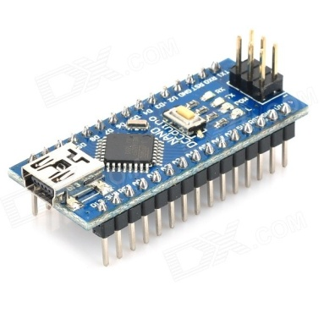
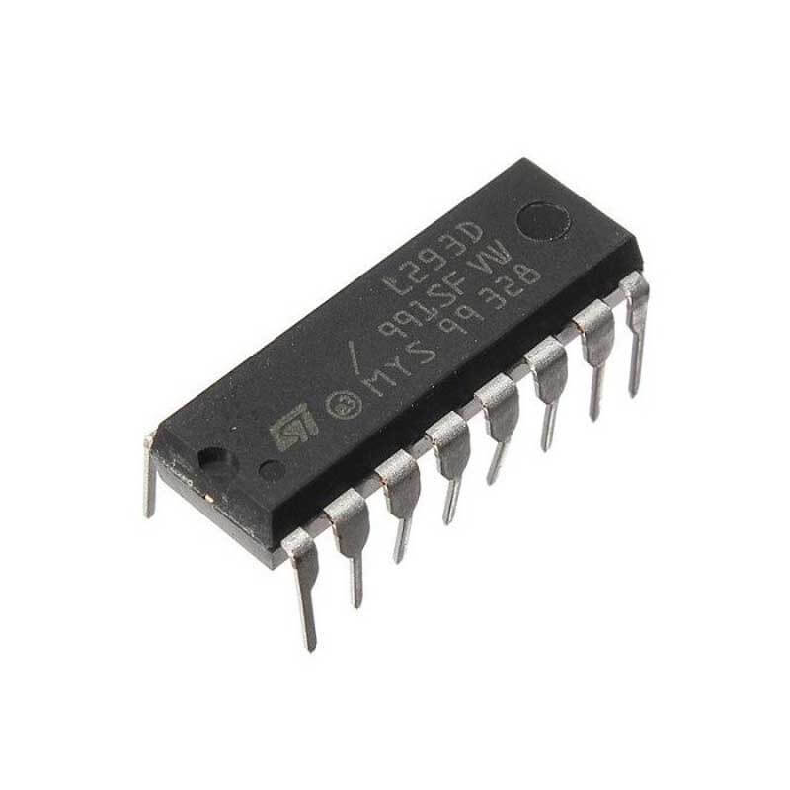
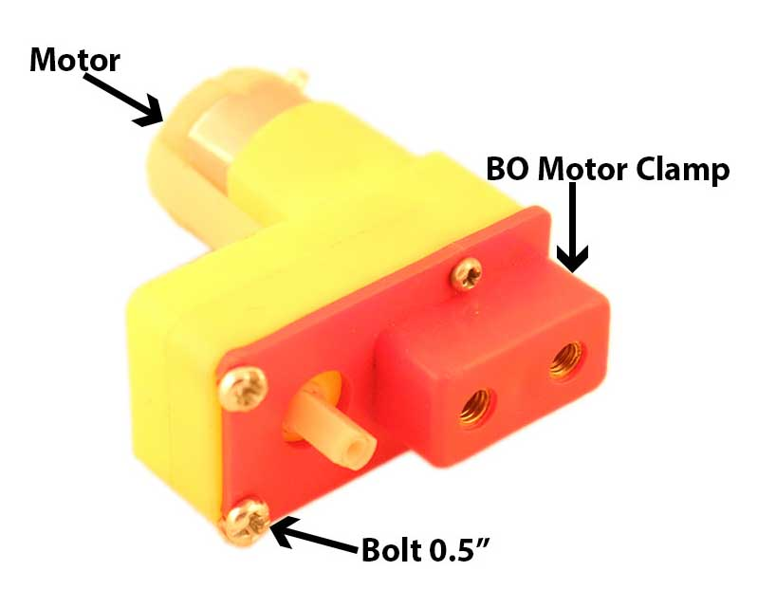
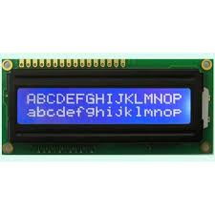
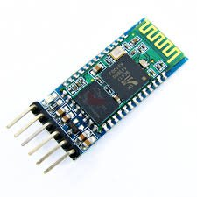
COMPONENTS
Arduino Nano
Bluetooth module
L293D ic motor driver ic
Bo motor
Chassis and wheels
12v battery
6x2 Liquid Crystal Display

Slide 4
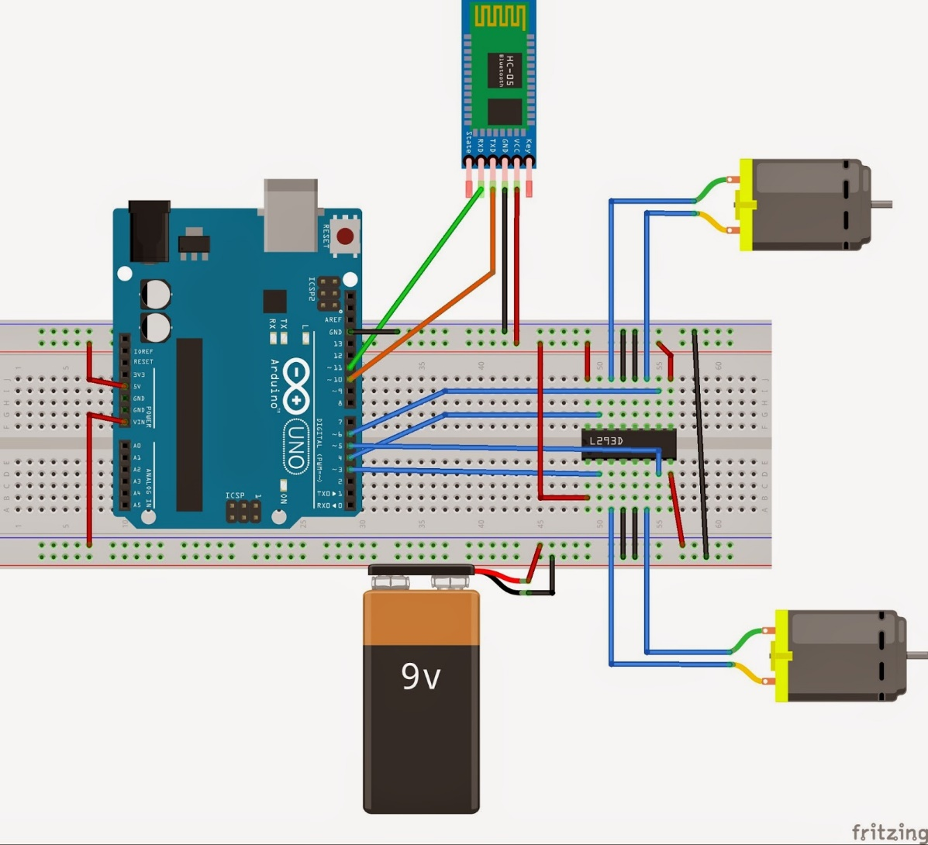
Circuit Diagram

Slide 5
Components Specification
Arduino Nano
Bluetooth HC-05
Atmega 328p microcontroller
32kb flash memory
16Mhz clock
5-12V operating voltage
2.4GHz digital wireless trans receiver
Low power
UART interface
10m range
DC Motors
16x2 liquid Crystal Display
60RPM torque
5- 12V operating voltage
600mA current consumption
5V operation
Low power
8 bit LVDS interface

Slide 6
WORKING
In this project we have used a toy car for demonstration.
This car have two dc motors at its rear side. Front side wheel is used for giving direction to car means turning left or right side (like real car steering feature). And rear side motor is used for driving the car in forward and backward direction.
A Bluetooth module is used to receive command from android phone and Arduino NANO is used for controlling the whole system.
Bluetooth controlled car moves according to button touched in the android Bluetooth mobile app.
While moving forward if any obstacle is came in front of this bot it make a turn and avoid that obstacle
To run this project first we need to download Bluetooth app form Google play store. We can use any Bluetooth app that supporting or can send data.

Slide 7
THANK YOU

